Slide 1









Group
Project
SANDRA HARO

Slide 2





Introduction
We talk about Motivational Letters.

Slide 3




Structure

Slide 4



Objectives
1
2
3
Tell them about yourself. Who are you? What makes you interesting and unique? Your most unique traits.
Tell them why you are interested in the city/culture. Going to courses does provide you with an opportunity to meet new cultures, perspectives, and ways of life. Tell them how much it excites you!
Tell them how crazy good the topic is. The topic should improve your education/career, and if you really don‘t care about it, reconsider picking a course where you do.

Slide 5


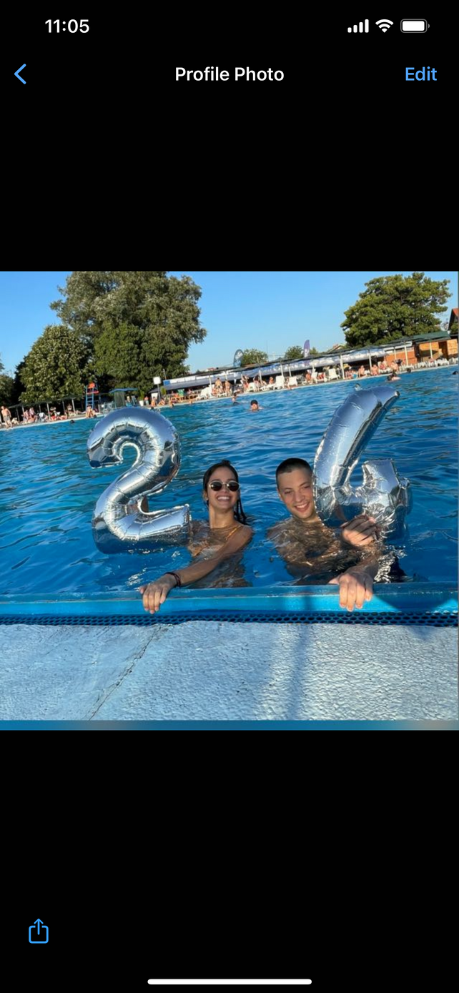
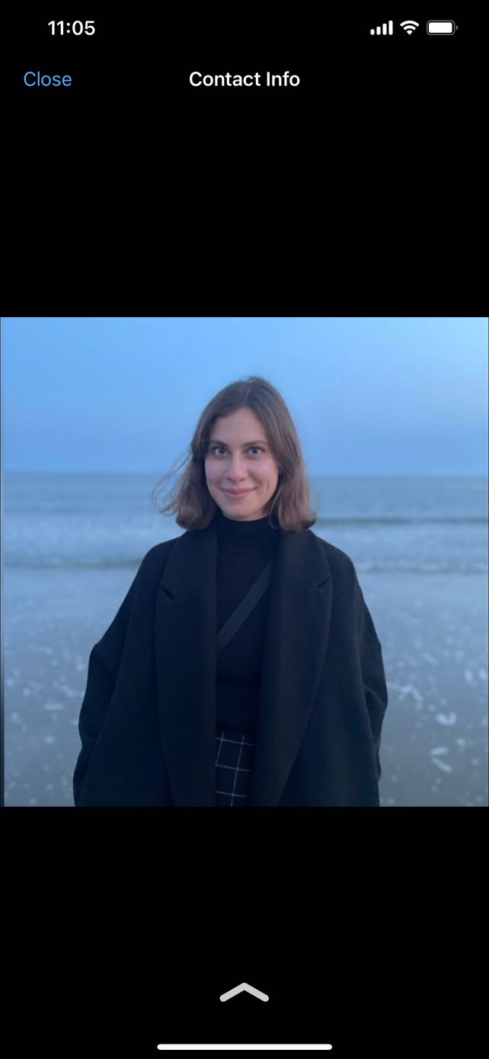

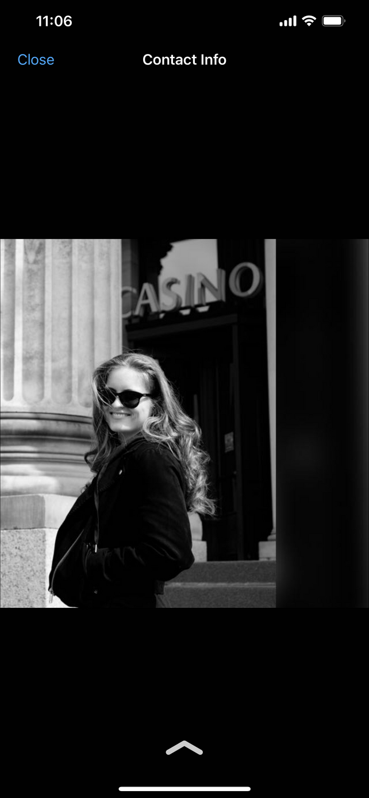

The team
Zuzu
Köta
Tinoslav

Slide 6




Zuzu’s ML
Hi, my name is Zuzu Drop. I am doing my master's studies at TU Wien and working beside it. I like to joke around a lot, and my friends tell me I am funny, so if you accept me you can expect to have crazy amounts of fun. Spending time doing sports is something I enjoy, as well as drinking tea in the evening and watching Star Wars :)

Slide 7





Another Zuzu
Hi BEST Budapest! I am Zuzu Drop. A TU Vienna student, who doesn’t have enough stress in her life, so also works beside her uni. In order to cope with all life's stress I have developed very sophisticated humour. So if everything goes wrong in the course, with me you will be at least laughing. As I have 2 siblings, I have developed a quite competitive spirit. So you can expect to see me spending my time in all kinds of sport fields trying to prove I am the best one. When I am not proving my abilities on the field, I like to relax with a cup of tea in front of Star Wars movie :)

Slide 8
Köta’s ML
Hello! My name is Köta Harschanji. I am an architecture student who loves taking pictures. When I am not studying I like to spend my time enjoying art. Going to exhibitions, museums, and theater sounds like my type of fun. Besides that, I also love meeting new people and enjoy everything that allows me to broaden my perspective on the world.

Slide 9
Another Köta
My dear motivational letter reader, thank you for spending time on this letter. I, Köta Harschanji, will do my BEST to make it worthwhile. I come from Budapest, where you can spend a lot of time around beautiful sights. This setting prompted me to start taking pictures, to try to capture the beauty, but also to study architecture. When I am not studying I like to spend my time enjoying art. I love interpreting it, thinking about the history behind it, or what was the message of author. This helps me think about other perspectives he/she had. That is probably the reason why I love meeting new people as well. I truly believe that learning about different cultures can help me be better person.

Slide 10
Tinoslav Kicanovic’s ML
Hi dear people, I am Kicia, a 100 kilos of pure fun. Besides working very hard to keep my weight Balkan-appropriate (100-120kg for men), I enjoy partying, drinking, and deep talks while absolutely wasted. In my country, we start celebrating life very early, so if you need a party starter, I am your guy. On rare occasions when I am not drinking or eating I enjoy playing games. In Vienna, during COVID I learned about board games and you cannot imagine my surprise when I realized not all of them have to be about drinking! Since then, I cannot get enough of them.

Slide 11
Another Tino
Hi dear besties, I am Kicia. I am too old for this. Last time I drank until 4 am I couldn’t sober up for 3 days, and with that, I failed my exam. I need to get my life together not party, send help and don’t accept me.

Slide 12


THANK YOU

